Slide 1
Impact Analysis of 5G Launch on Revenue and Key Performance Indicators

Slide 2
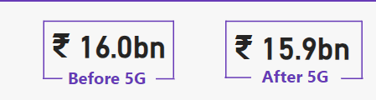
Impact on Revenue

Slide 3
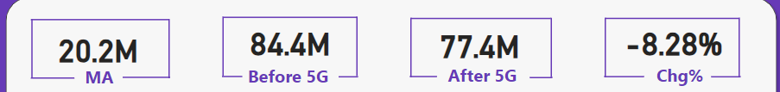
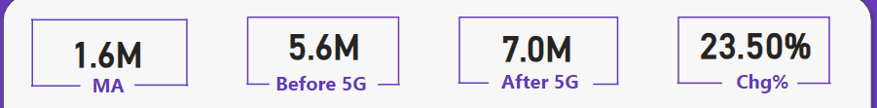
Underperforming KPIs after 5G Launch
Total Active Users (TAU)
Total Unsubscribe Users (TUsU)

Slide 4
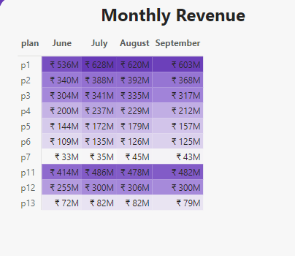
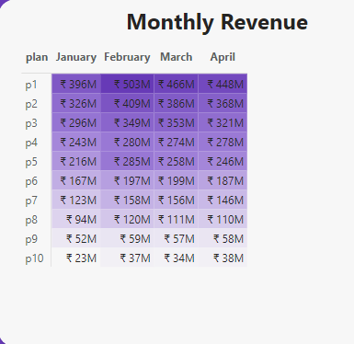
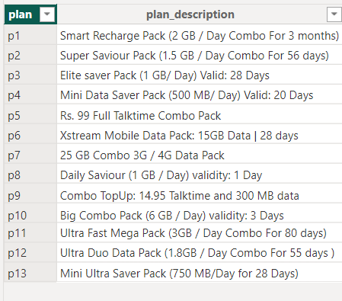
Revenue Performance by Plans
After 5G
Before 5G
Plans Performing Well:
P1
P11
P2
P3
Plans Not Performing Well:
P7
P13

Slide 5
Plans Affected Largely by 5G Launch
Plans Affected:
P7
After 5G
Before 5G

Slide 6
Discontinued Plans after 5G Launch
After 5G
Before 5G
Discontinued Plans:
P8
P9
P10
New Plans introduced in place of P8,P9 and P10
New Plans: P11, P12, P13

Slide 7


